Slide 1
Microsoft 365 Enterprise
License Map – 2019-05
@AaronDinnage

Slide 2
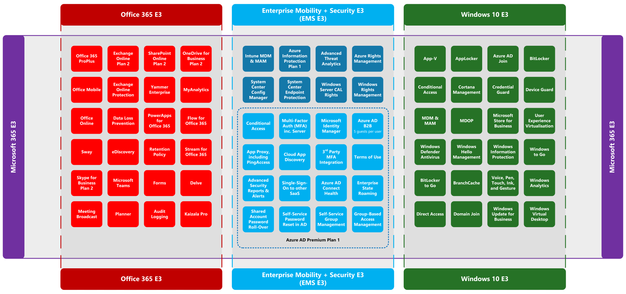

Slide 3
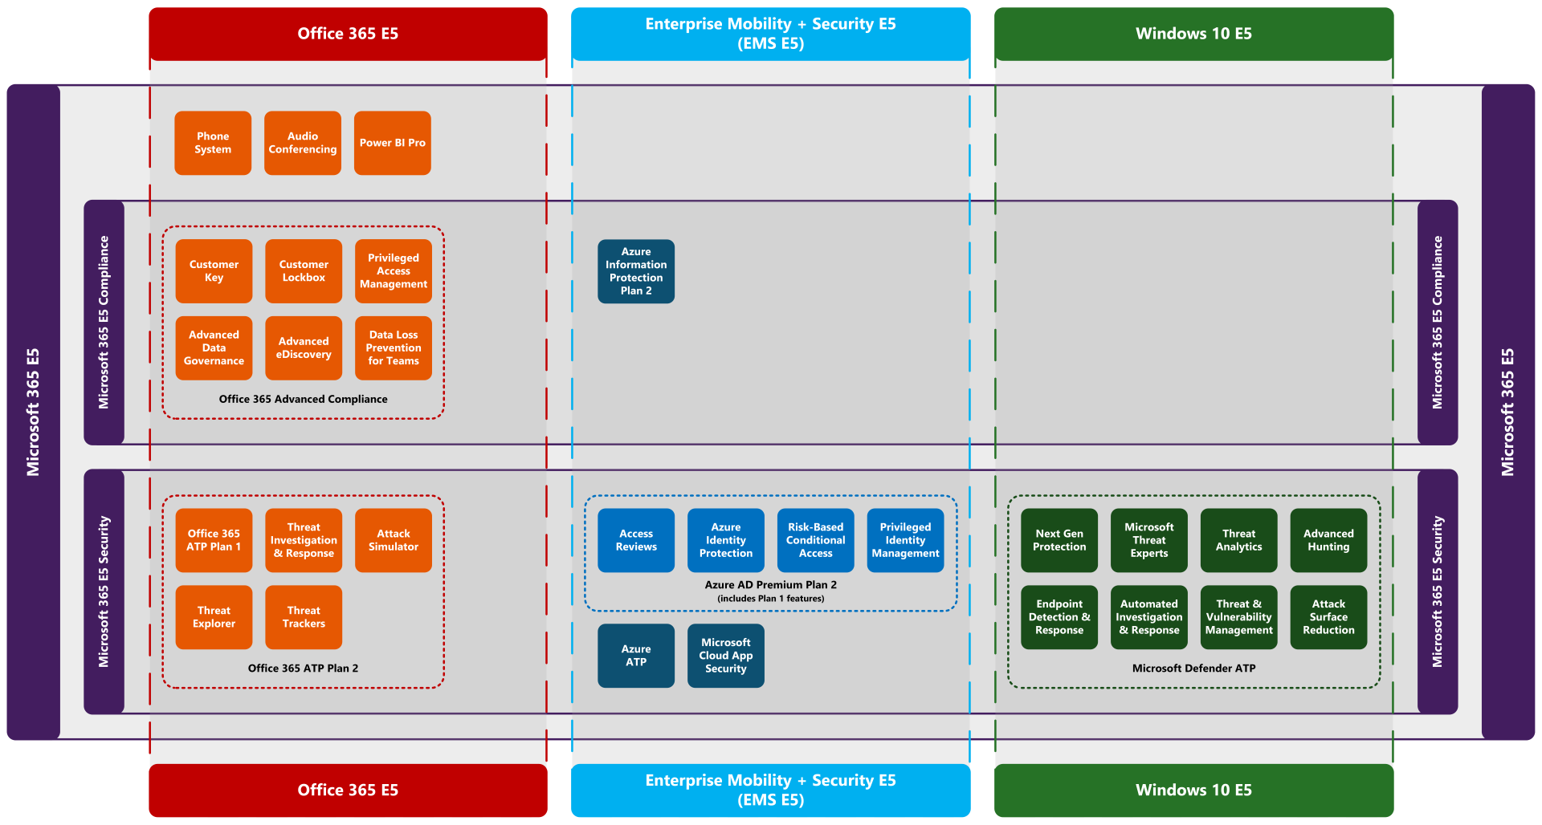

Slide 4
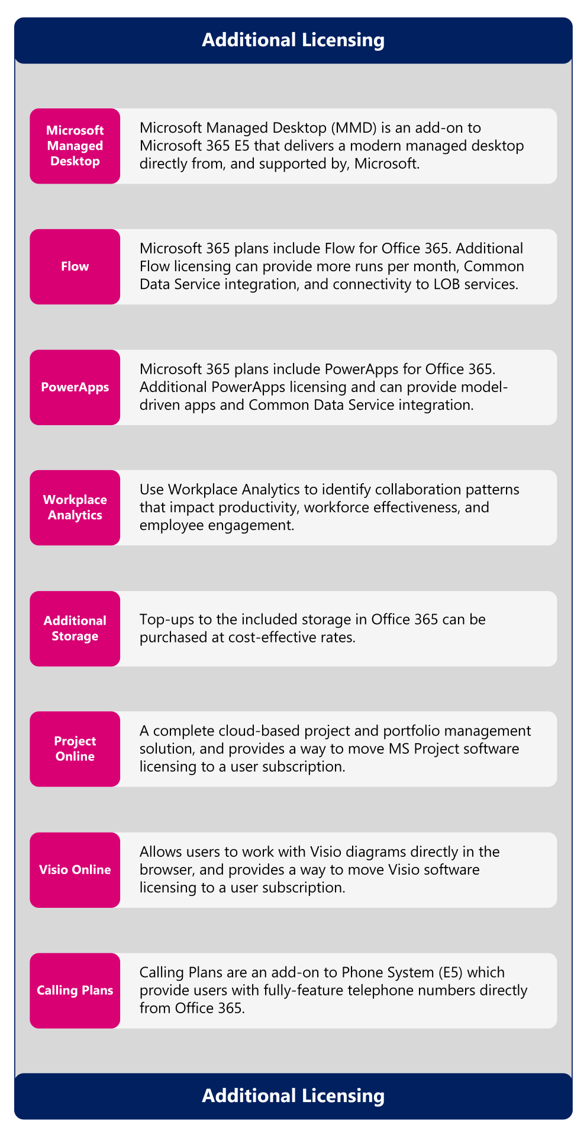
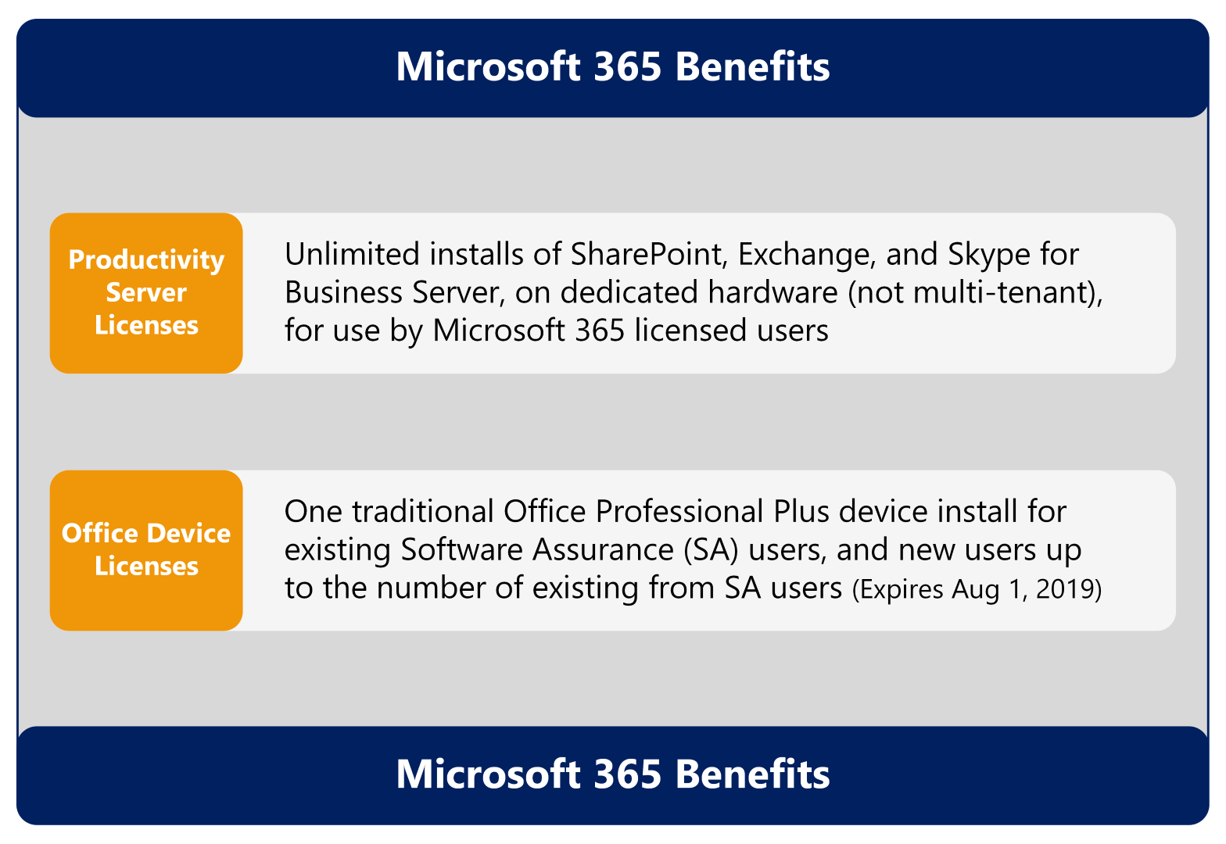
Microsoft 365 Benefits and Additional Licensing

